Slide 1
THEORY OF STRUCTURES -------------------- DR. WISSAM D. SALMAN
Deflections using energy method
The work done by all external forces acting on a structure, Ue, is transformed to internal work or strain energy,Ui, if the material's elastic limit is not exceeded, the elastic strain energy will return the structure to its undeformed state when the loads are removed.
Ue=Ui
External work: represents the area of the loads(force,moment)-deformation(deflection, rotation) diagrams.
If vertical bar has constant area(A), length(L), and elastic modulus (E) subjected to external force that applied gradually from zero to P, then the diagram of load-∆ can constructed as shown.
If the magnitude of applied force is increased by amount N beyond P, then this increment force will cause additional deflection ∆' as shown

Slide 2
THEORY OF STRUCTURES -------------------- DR. WISSAM D. SALMAN
The work done by P not N when the bar undergoes the further deflection ∆' is then
Ue=P∆'
As in the case of force, if the moment is applied gradually to a structure having linear elastic response from zero to M, the external work is then
However, if the moment is already applied to the structure and other loadings further distort the structure by an amount M rotates θ', and the work is
Ue'=Mθ'
Internal work(strain energy): the area of stress-strain diagram multiplied by volume of structure is called strain energy , if the material
within elastic limit , the relation between stress & strain is linear as shown
∫
In case of axial member such as (truss, any member
Subjected to axial force only)

Slide 3
THEORY OF STRUCTURES -------------------- DR. WISSAM D. SALMAN
In case of flexural member as shown
dvol=b dy dx
∫ ∫
∫ ∫
∫
∫
Principle of virtual work
The principle of virtual work was developed by john berouli in 1717 and sometime referred to as the unit- load method. It provides a general means of obtaining the displacement and slope at a specific point on a structure, be it a beam , frame or truss.
Assume arbitrary structure subjected to several forces as shown to find displacement at point A , apply virtual force of one unit in
direction of displacement as shown

Slide 4
THEORY OF STRUCTURES -------------------- DR. WISSAM D. SALMAN
Assume virtual load is applied first then real loads is applied and cause ∆, then external work done by virtual load throughout ∆, is
Ue=1*∆
While internal work is Ui=∑u*dL
Ue=Ui
1*∆=∑u*dL
1=external virtual unit load acting in the direction of ∆.
u=internal virtual load acting on the element in the direction of dL.
∆=external displacement caused by the real loads.
dL=internal deformation of the element caused by the real loads.
In a similar manner, if the rotational displacement or slope of the tangent at a point on a structure is to be determined , a virtual couple moment M' having a unit magnitude is applied at the point.
θ=∑u_{θ} .dL
u_{θ}=internal virtual load acting on an element in the direction of dL
θ=external rotational displacement or slope in radians caused by the real loads dL=internal deformation of the element caused by the real loads.
Application of unit-load method
Truss
Deflections in trusses are caused by , external loads, temperature ,and fabrication error
∑ ∑ ∑
Where
1=external virtual unit load acting on the truss joint in the state direction of ∆.

Slide 5
THEORY OF STRUCTURES -------------------- DR. WISSAM D. SALMAN
n=internal virtual normal force in a truss member caused by the external virtual unit load
N=internal normal force in a truss member caused by the real loads L=length of member
A=cross-sectional area of a member E=modulus of elasticity of a member
α=coefficient of thermal expansion of member
∆T=change in temperature of member (T2-T1)
∆L=difference in length of the member from its intended size as caused by a fabrication error.(+ if there is increment or - if there is decrement)
Example:- determine the vertical displacement of joint B using unit-load method . for each steel member A=900 mm². E=200
Gpa.

Slide 6
THEORY OF STRUCTURES -------------------- DR. WISSAM D. SALMAN
member | L | N | n | nNL
AB | 2.4 | 6.667 | 0.667 | 10.673
BC | 2.4 | 0 | 0 | 0
FE | 2.4 | 0 | 0 | 0
ED | 2.4 | -6.667 | -0.667 | 10.673
AF | 1.8 | -10 | 0 | 0
BE | 1.8 | -5 | 0.5 | -4.5
CD | 1.8 | -15 | -0.5 | 13.5
AE | 3 | -8.333 | -0.833 | 20.824
BD | 3 | 8.333 | 0.833 | 20.824
∑ |  |  |  | 71.994
∑

Slide 7
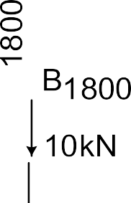
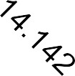
THEORY OF STRUCTURES -------------------- DR. WISSAM D. SALMAN
Example:- by using unit-load method to determine the vertical deflection at point B due to applied loads, increase temperature of 110ºc at members AB& BC, and fabrication error at member EB of 19mm too long. Take E=200GPa, and α=1.8*10⁻⁶/ ºc

Slide 8
THEORY OF STRUCTURES -------------------- DR. WISSAM D. SALMAN
Member | L(M) | N(kN) | n | α∆T | ERROR | Amm² | NnL/A kN.m/ mm² | n α∆TL (m) | N ∆L (mm)
AB | 1.2 | -30 | -1 | 1.98X10⁻⁶ | 0 | 1800 | 0.02 | -0.000238 | 0
BC | 1.2 | -10 | 0 | 1.98X10⁻⁶ | 0 | 1800 | 0 | 0 | 0
ED | 1.2 | 10 | 0 | 0 | 0 | 1200 | 0 | 0 | 0
BD | 1.2 | -10 | 0 | 0 | 0 | 1800 | 0 | 0 | 0
EB | 2.828 | 28.284 | 1.414 | 0 | 19mm | 1200 | 0.0566 | 0 | 26.87
DC | 2.828 | 14.142 | 0 | 0 | 0 | 1200 | 0 | 0 | 0
∑ |  |  |  |  |  |  | 0.0766 | -0.000238 | 26.87
∑ ∑ ∑
2. .beam
The method of unit-load can also be applied to deflection problems involving beams, to determine deflection at any point within beam; one unit is applied at this point. In addition, the tangent (rotation) at any point can be determined by applying unit- moment at this point.
The following laws are applied to determine deflection and rotation, respectively.
∫
∫
Where,
m= internal virtual moment in the beam or frame, expressed as function of x and caused by the external virtual unit load.

Slide 9
THEORY OF STRUCTURES -------------------- DR. WISSAM D. SALMAN
m_{θ}= internal virtual moment in the beam or frame, expressed as function of x and caused by the external virtual unit load.
∆,θ=external displacement and rotation of the point caused by the real loads acting on the beam or frame.
M=internal moment in the beam or frame , expressed as a function of x and caused by the real loads.
E=modulus of elasticity of the material I=moment of inertia of cross-sectional area.
Important note:-
Frame and beam can be divided into pieces. One piece has ends may be, 1- Exterior or interior support
2- Point of applying concentrated load or moment 3- End points of distributed load or moment
Point of discontinuity of properties of beam or frame ( such as change area, and material)
Point of applying virtual unit load or moment 6- Internal hinge
Example: use unit load method; determine the slope at point B of the steel beam. E=200 G Pa , I=70X10⁶mm⁴

Slide 10
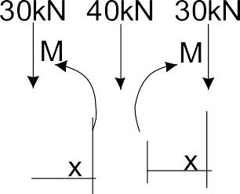
THEORY OF STRUCTURES -------------------- DR. WISSAM D. SALMAN
Portion | AB | BC
Origin | A | C
Limits | 0---10 | 0---5
M | -2.5x | -2X²/2
m | -0.1x | 0
EI | EI | EI
∫ ∫
Example: use unit load method; determine the slope at point B ,and deflection at point C of the steel beam. E=200 G Pa ,
I=270X10⁶mm⁴

Slide 11
THEORY OF STRUCTURES -------------------- DR. WISSAM D. SALMAN
Portion | AB | BC | CD | ED
Origin | A | B | D | E
Limits | 0-4 | 0-2 | 0-2 | 0-4
M | 50x | 50(4+x)-30x= 20X+200 | 50(4+x)-30x= 20X+200 | 50x
m1 | 0.5x | 0.5(4+x)= 0.5x+2 | 0.5(4+x)= 0.5x+2 | 0.5x
m2 | -0.083x | -0.083(4+x)+1= 0.917x-0.332 | 0.083(4+x)= 0.083x+0.332 | 0.083x
EI | EI | 2EI | 2EI | EI
∫
∫ ∫
∫ ∫

Slide 12
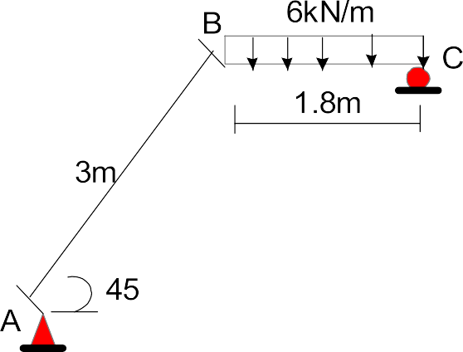
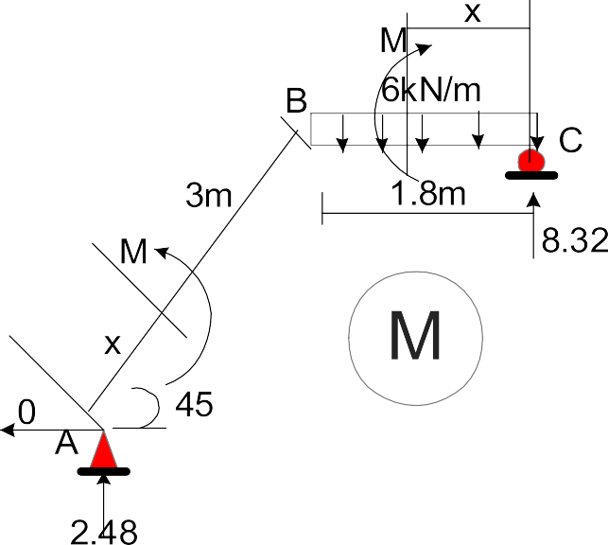
THEORY OF STRUCTURES -------------------- DR. WISSAM D. SALMAN
∫
∫ ∫
∫
∫
Example:- using unit load method determine horizontal deflection at C. EI is constant for all members.

Slide 13
THEORY OF STRUCTURES -------------------- DR. WISSAM D. SALMAN
Solution
REACTION IN CASE m
Portion | origin | limits | M | m
AB | A | 0-3 | 2.48*xcos45=1.75x | Xsin45-0.54*xcos45=0.33x
CB | C | 0-1.8 | 8.32x-6x²/2=8.32x-3x² | 0.54x
∫
∫
H.w
Determine slopes at points A,B,andC
If support at c is pin instead of roller and there is internal hinge at point B, determine the slope at point B
Determine the vertical displacement at half distance between B&c in both cases.

Slide 14
THEORY OF STRUCTURES -------------------- DR. WISSAM D. SALMAN
3-Arch
Example:- determine the vertical deflection at B, EI=6*10⁴ kN.m² In the arch problem replace dx by Rdθ
M=5(10-10cosθ)-5*10*sinθ=50(1-cosθ-sinθ)
m=M/10
∫
∫

Slide 15
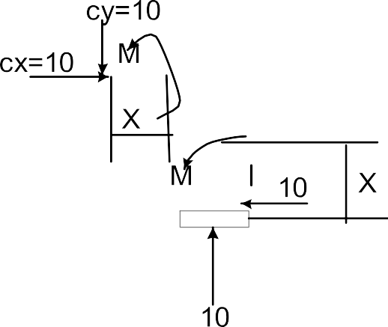
THEORY OF STRUCTURES -------------------- DR. WISSAM D. SALMAN
4-composite structure
∫ ∑ ∑ ∑
Example:-using unit load method determine vertical deflection at D , EA for axial members is 10⁵ kN,and EI for flexural members is 10⁴kN.m².
From F.B.D of truss
∑MA=0
Cy=10 upward
From F.B.D of frame
∑MI=0
Cx=10 to left

Slide 16
THEORY OF STRUCTURES -------------------- DR. WISSAM D. SALMAN
Then all truss member forces can be determined
Here m=M/10 n=N/10
∫ ∑
∫ ∑ ∫
∫

